Slide 1
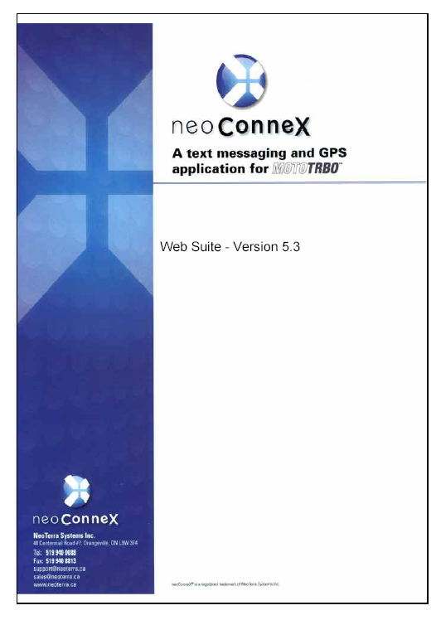
Web-Based GPS Tracking Tool
For Use With The
FleetTALK Management Services
MotoTRBO System

Slide 2
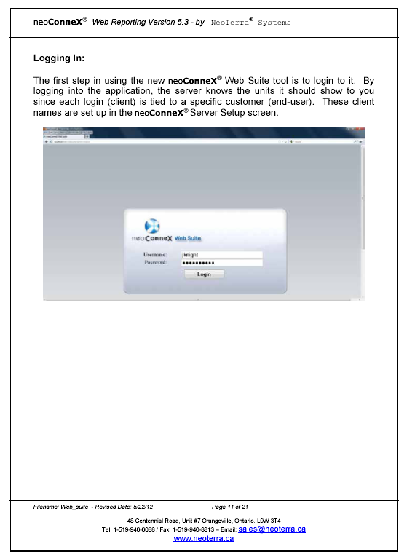
http://www.fleettalkgps.com:8081

Slide 3
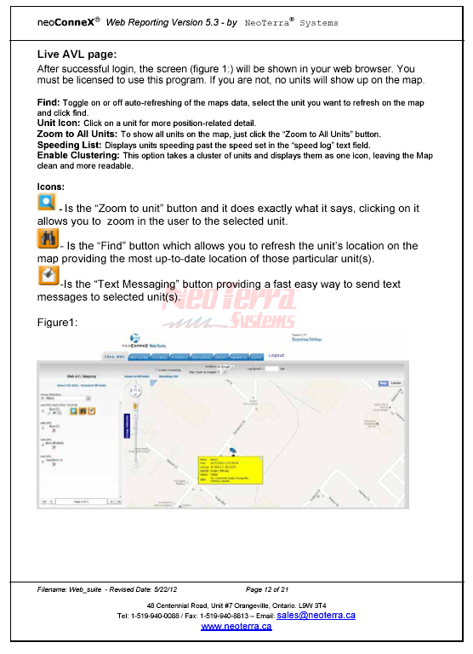

Slide 4
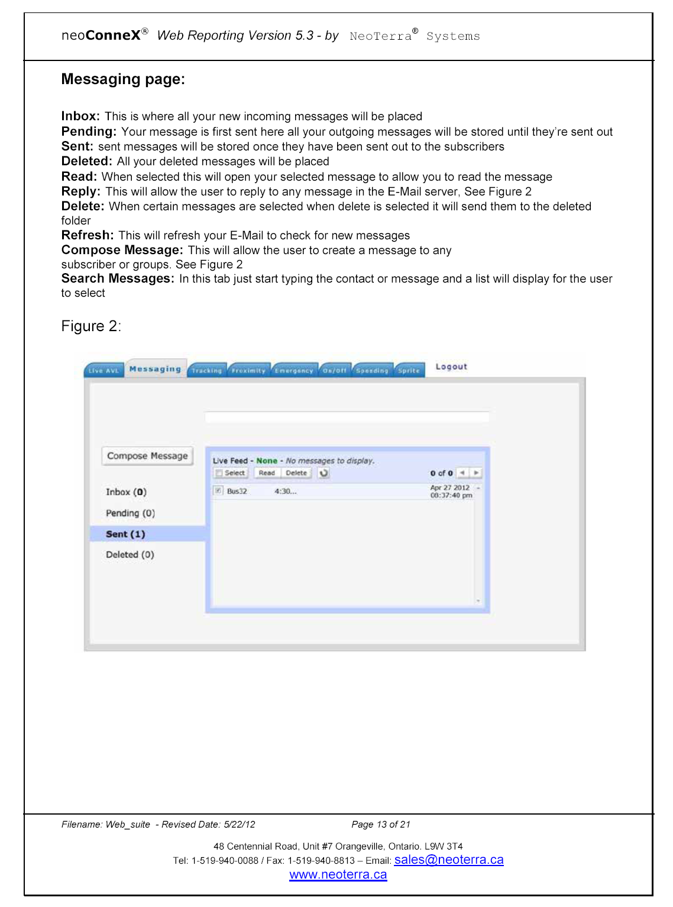

Slide 5
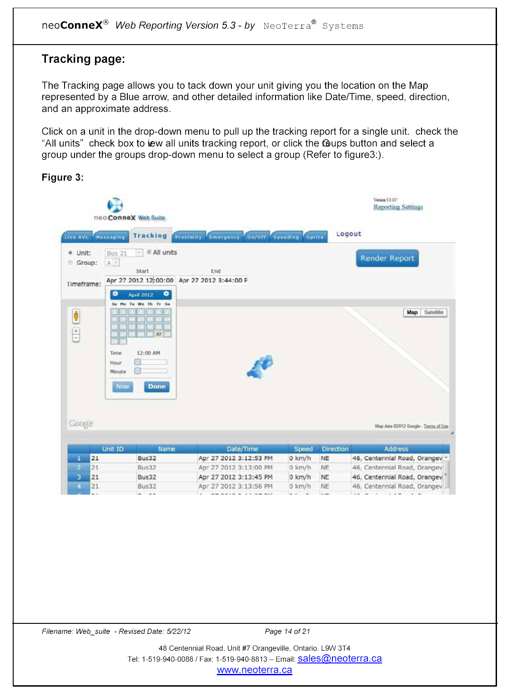
neoterra.ca

